Slide 1

YAY! - Celebrating Education

Slide 2

Know your Mentor!

Slide 3
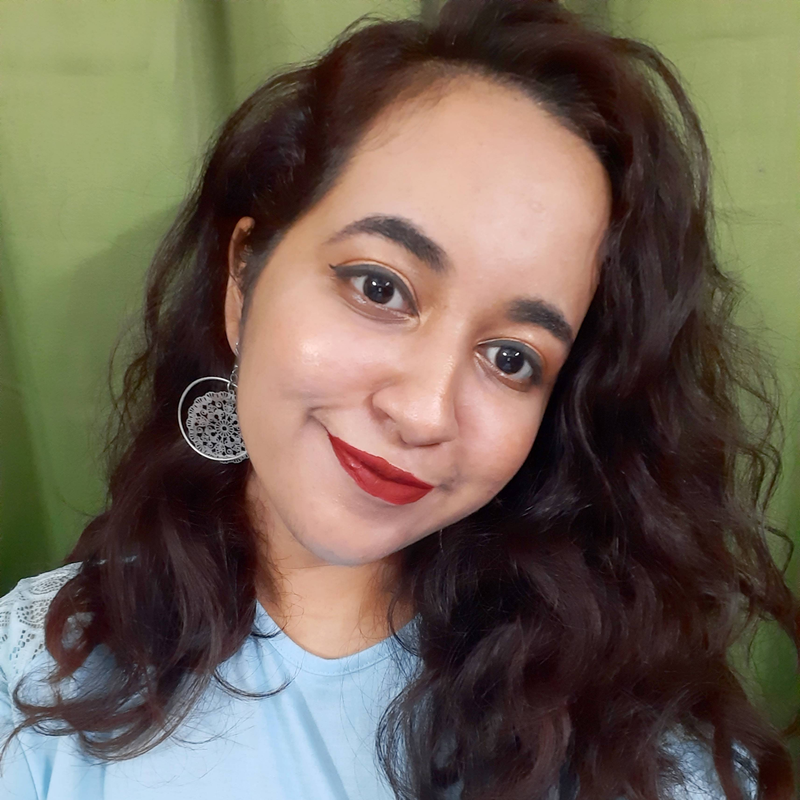


Jasleen Kaur Sondhi
Final year student pursing triple majors in Physics, Mathematics and Computer Science, Mount Carmel College, Bangalore.
R Programming Intern at SIRPI, Visualize and Decide.
Beta Microsoft Learn Student Ambassador.
R Programming Textbook Companion under publication process by IIT Bombay, FOSSEE Fellowship.
Certified by Duke University in Data Science Math Skills.
Skills- R, Python, Data Science, Tableau (among others)
Taught several batches at Yay-Lets Celebrate Education.
https://www.linkedin.com/in/jasleen-sondhi/
https://github.com/jasleen101010

